Slide 1
A Survey on Medical Image Segmentation using Supervised Deep Learning Approaches
Name : Chinmay Vadgama ( ID : 014551407 )

Slide 2
Medical Imaging
One of the oldest life sciences applications for vision based systems is Medical Imaging.
Medical Image segmentation can be used to help researchers, physicians, and surgeons identify specific details on medical images.
Image segmentation involves dividing the CT scans, MRIs, and X-ray images, for example, into multiple parts to identify relevant information that is then used to diagnose, provide therapy, and perform surgery.

Slide 3
Deep Learning and Medical Image Segmentation
Medical Image segmentation has been in radar of computer vision and medical experts for years.
Earlier in Medical Image Segmentation was researched using traditional image processing techniques.
Traditional approaches took lot of effort and time in devising proper feature set for the task.
After inception of deep learning techniques it became easier to model the task as deep learning architectures learned feature sets inherently.
There has been lot of research paper in medical image segmentation in recent years and tracking them all is hard task.

Slide 4
Problems with Medical Image Segmentation Task
Image segmentation is still one of the most challenging topics in the field of computer vision due to the difficulty of feature representation.
In particular, it is more difficult to extract discriminating features from medical images than normal RGB images since the former often suffers from problems of blur, noise, low contrast, etc.

Slide 5
Supervised Approaches
Right now supervised and weakly supervised approaches are popular for medical image segmentation task.
There has been lot of research in unsupervised learning side as well but those are not that popular or widely accepted.
Supervised model architecture can be evaluated in following ways :
Backbone networks
Network blocks
Different loss functions

Slide 6
Backbone Architectures / Feature Extractor Network
Semantic segmentation of an image aims to achieve pixel classification.
For this purpose researchers employed encoder-decoder architecture which can provide better feature representation.
Generally deeper network achieves higher accuracy.
There are several different network architectures as backbone architectures:
3D Nets
RNN & LSTM time/sequence dependent networks
Skip connection based networks
Cascade
Generative adversarial methods : GAN based models

Slide 7
Network Blocks
Dense Connection Layers
Inception :
For CNNs, deep networks often give better performances than shallow ones, but they encounter some new problems such as vanishing gradient, the difficulty of network convergence, the requirement of large memory usage, etc.
The inception structure overcomes these problems. It gives better performance by merging convolution kernels in parallel without increasing the depth of networks.
Attention Mechanism

Slide 8
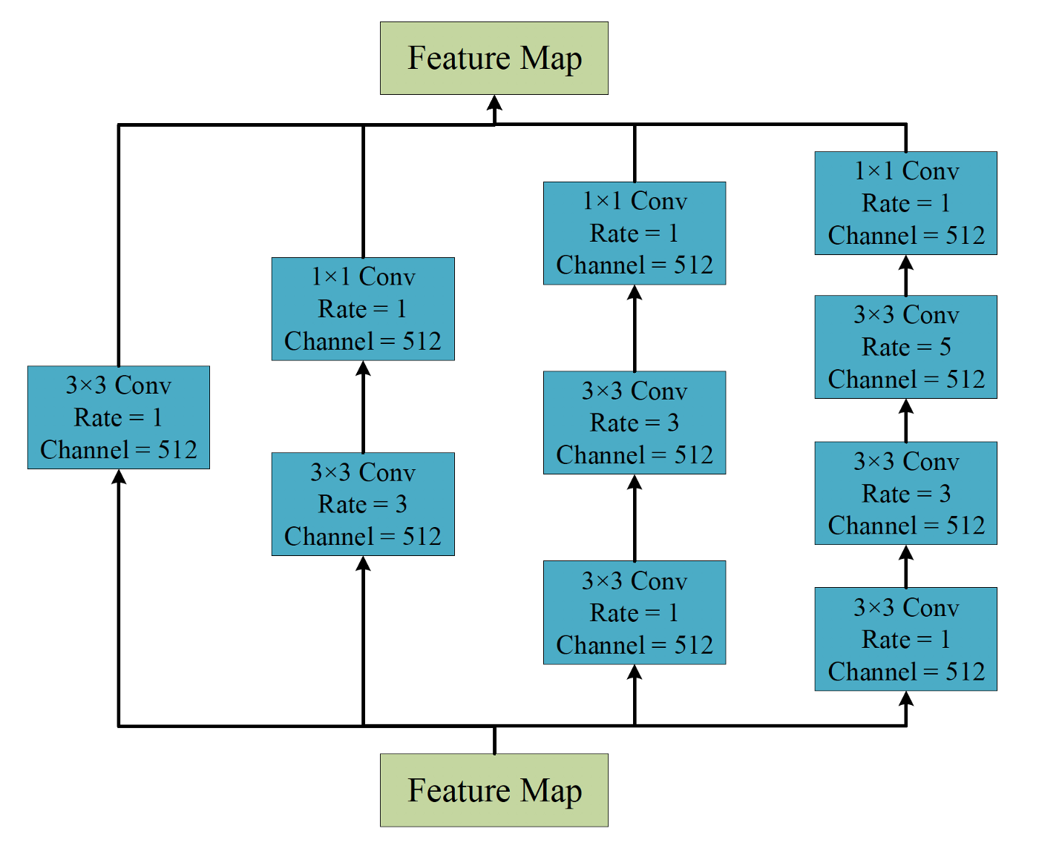

Slide 9
Loss Functions
Cross Entropy Loss
Weighted Cross Entropy Loss
addresses challenge of class imbalancing which occurs in cross entropy loss
Overcomes fallacies of cross entropy loss which considers all pixels of an image and averages out all at the end.
Dice loss
Measures overlap between segmentation and original ground truth value.

Slide 10
Thank You.

